Slide 1
Review – Backpropagation
Backpropagation is the most well know and widely used neural network system
It is a multi-layered, feedfoward, perceptron-like structure
Uses the backpropagation rule (or generalized delta rule) for training

Slide 2
Backpropagation Training
Training Algorithm 1
Backpropagation Training
Applications
  IDS
  Eyes
OUTLINE
Step 0: Initialize the weights to small random values
Step 1: Feed the training sample through the network and determine the final output
Step 2: Compute the error for each output unit, for unit k it is:
Actual output
δ_{k} =
(t_{k} – y_{k})f’(y_in_{k})
Required output
Derivative of f

Slide 3
Training Algorithm 2
Step 3: Calculate the weight correction term for each output unit, for unit k it is:
Hidden layer signal
Δw_{jk} = αδ_{k}z_{j}
A small constant

Slide 4
Training Algorithm 3
Step 4: Propagate the delta terms (errors) back through the weights of the hidden units where the delta input for the j^{th} hidden unit is:
Σ
m
δ_in_{j} = δ_{k}w_{jk}
k=1
The delta term for the j^{th} hidden unit is:
δ_{j} = δ_in_{j}f’(z_in_{j})

Slide 5
Training Algorithm 4
Step 5: Calculate the weight correction term for the hidden units:
Step 6: Update the weights:
Step 7: Test for stopping (maximum cylces, small changes, etc)
Δw_{ij} = αδ_{j}x_{i}
w_{jk}(new) = w_{jk}(old) + Δw_{jk}

Slide 6
Options
There are a number of options in the design of a backprop system
  Initial weights – best to set the initial weights (and all other free parameters) to random numbers inside a small range of values (say –0.5 to 0.5)
  Number of cycles – tend to be quite large for backprop systems
  Number of neurons in the hidden layer – as few as possible

Slide 7
Example
The XOR function could not be solved by a single layer perceptron network
The function is:
X Y F
0 0 0
0 1 1
1 0 1
1 1 0

Slide 8
XOR Architecture
1
v₁₁
1
x
v₂₁
Σ
f
v₃₁
w₁₁
w₂₁
Σ
f
1
w₃₁
y
v₁₂
v₂₂
Σ
f
v₃₂

Slide 9
Initial Weights
Randomly assign small weight values:
1
-.3
1
x
.21
Σ
f
.15
-.4
-.2
Σ
f
1
.3
y
.25
-.4
Σ
f
.1

Slide 10
Feedfoward – 1st Pass
1
1
s₁ = -.3(1) + .21(0) + .25(0) = -.3
f = .43
1
-.3
1
0
Σ
f
s₃ = -.4(1) - .2(.43)
+.3(.56) = -.318
x
.21
.15
-.4
-.2
Σ
f
1
f = .42
1
.3
(not 0)
s₂ = .25(1) -.4(0) + .1(0)
y
0
.25
-.4
Σ
f
.1
f = .56
Activation function f:
1
y_{j} =
Training Case: (0 0 0)
1 + e
s_{j}

Slide 11
Backpropagate
δ₃ =
(t₃ – y₃)f’(y_in₃)
=(t₃ – y₃)f(y_in₃)[1- f(y_in₃)]
1
-.3
1
0
.21
Σ
f
.15
-.4
δ_in₁ = δ₃w₁₃ = -.102(-.2) = .02
Σ
f
δ₁ = δ_in₁f’(z_in₁) = .02(.43)(1-.43)
= .005
-.2
1
.3
0
.25
-.4
Σ
f
δ₃ =
(0 – .42).42[1-.42]
.1
= -.102
δ_in₂ = δ₃w₁₂ = -.102(.3) = -.03
δ₂ = δ_in₂f’(z_in₂) = -.03(.56)(1-.56)
= -.007

Slide 12
Update the Weights – First Pass
δ₃ =
(t₃ – y₃)f’(y_in₃)
=(t₃ – y₃)f(y_in₃)[1- f(y_in₃)]
1
-.3
1
0
.21
Σ
f
.15
-.4
δ_in₁ = δ₃w₁₃ = -.102(-.2) = .02
Σ
f
δ₁ = δ_in₁f’(z_in₁) = .02(.43)(1-.43)
= .005
-.2
1
.3
0
.25
-.4
Σ
f
δ₃ =
(0 – .42).42[1-.42]
.1
= -.102
δ_in₂ = δ₃w₁₂ = -.102(.3) = -.03
δ₂ = δ_in₂f’(z_in₂) = -.03(.56)(1-.56)
= -.007

Slide 13
Final Result
After about 500 iterations:
1
-1.5
1
x
1
Σ
f
1
-.5
-2
Σ
f
1
1
y
-.5
1
Σ
f
1

Slide 14
Applications
Intrusion Detection Systems
Anomaly Detection - The identification of unauthorized system usage by discovering statistical variances from established norm, (e.g., profiles of authorized users). Primarily used for detecting internal intrusions.
Misuse Detection - The detection of external attacks (“hackers”, etc.). Traditionally addressed by matching current activities to established attacks patterns.

Slide 15

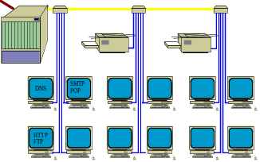
Sentinel
GOAL: Initial design and development of a neural network-based misuse detection system which explores the use of this technology in the identification of instances of external attacks on a computer network.
Internet
SENTINEL
Intrusion
Response

Slide 16
t = 180
………………
h t t p : / / e s e t . s c I s
s u p e r v I s o r
a n o n y m o u s
h t t p : / / w w w . g t I s c
f t p : / / a s t r o . g a t c
Network
Stream
l o g o u t
h t t p : / / e s e t . s c I s
f t p : / / a s t r o . g a t c
Raw Data and Destination Port of Network Packets
t e l n e t c I s , n o v a .
s u p e r v I s o r
a d m I n I s t r a t o r
h t t p : / / w w w . c n n . c
h t t p : / / w w w . g t I s c
h t t p : / / w w w . m i c r o
a n o n y m o u s
Self-Organizing Map
Results of SOM Event Classification
….
Multi-Level
Perceptron
Neural Network Output

Slide 17
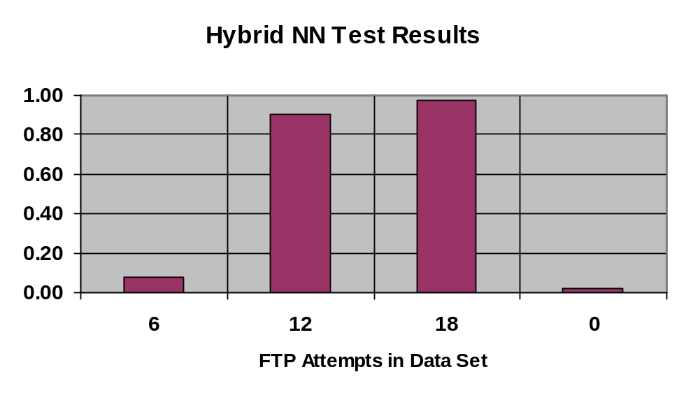
Results
Tested with data sets containing 6, 12, 18, and 0 “attacks” in each 180 event data set
Successfully detected >= 12 “attacks” in test cases
Failed to “alert” in lower number of “attacks” (per design)

Slide 18
An automatic screening system for Diabetic Retinopathy
Visual Features:
  Nerve: Circular yellow and bright area from which vessels emerge
  Macula: Dark elliptic red area
  Microaneurysms: Small scattered red and dark spots (in the order of 10x10 pixels in our database of images)
  Haemorrhages: Larger red blots
  Cotton spots (exudates): Yellow blots

Slide 19
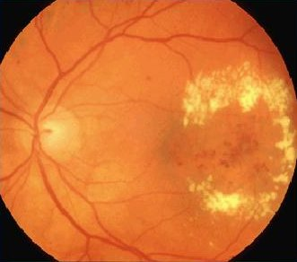
Example
Cotton Spots:

Slide 20
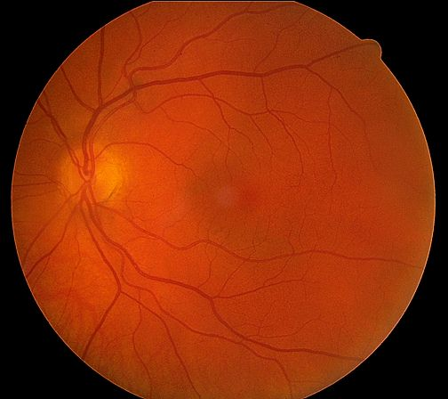



Approach
A moving window searches for the
matching pattern
Miss or Match
Miss
…
Miss
Match
NN trained to
recognize nerves
Test window

Slide 21
Possible Quiz
What can vary in a backpropagation system?
What is misuse detection?
What is backpropagated during training?
SUMMARY
Backpropagation Training
Applications
  IDS
  Eyes

